Slide 1

Rust
Waterford Tech Meetup January 2025

Slide 2

What?
Photographer - David Bergin

Slide 3
Rust
fn main() {
println!("Hello, world");
}

Slide 4
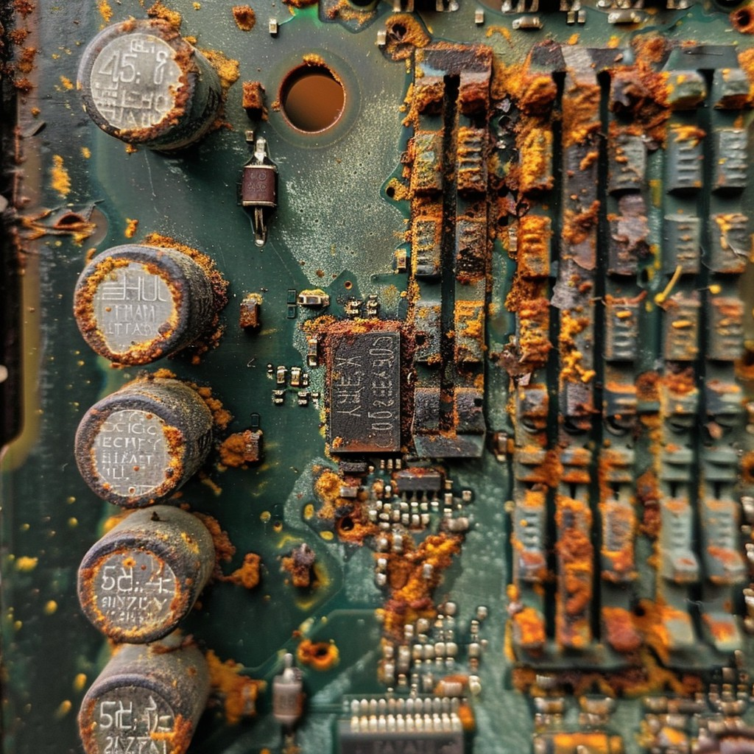
Rusty
Photo by Stockcake

Slide 5
Rust
fn main() {
thread::spawn(|| {
for i in 1..10 {
println!("hi number {i} from the spawned thread!");
thread::sleep(Duration::from_millis(1));
}
});
for i in 1..5 {
println!("hi number {i} from the main thread!");
thread::sleep(Duration::from_millis(1));
}
}

Slide 6

Rusty

Slide 7
Rust
use std::net::TcpListener;
fn main() {
let listener = TcpListener::bind("127.0.0.1:7878").unwrap();
for stream in listener.incoming() {
let stream = stream.unwrap();
println!("Connection established!");
}
}

Slide 8
Rusty
Cop on John!

Slide 9



Alright, Seriously… What is Rust?
Notes:
In 2006, Hoare was a 29-year-old computer programmer working for Mozilla
Returning home to his apartment in Vancouver, he found that the elevator was out of order; its software had crashed.
This wasn’t the first time it had happened, either.

Slide 10
Walking to the 21st Floor Graydon Pondered…
I know what I’ll do, I’ll create a new programming language and name it Rust after a fungi that is overengineered for survival!!
It was probably another bug with memory management!
I wonder if the elevator code was written in C?
We computer people
couldn’t even make an elevator that works
without crashing

Slide 11
Rust was born as a…
A general purpose programming language built for performance, reliability and productivity.

Slide 12
Rust is…
Typically referred to as a systems level programming language with an emphasis on memory safety

Slide 13
Systems Programming?
Low-level software that interacts closely with hardware, such as operating systems, drivers, networking stacks, and embedded systems.
Requires high performance, precise control over resources, and efficient memory management, making them critical for infrastructure and performance-sensitive applications.

Slide 14
Systems Programming?
Assembly
Used for hardware-level programming but lacks abstraction and portability.
C
Known for its low-level control and performance but prone to memory safety issues.
C++
Adds object-oriented features to C but retains similar risks of unsafe memory usage.
Go
Focused on simplicity and concurrency but lacks Rust's fine-grained control over memory.

Slide 15

What is memory safety?
#include <stdio.h>
int main(){
int initial_value = 60;
int items[5] = {1,2,3,4,5};
printf("initial value is %d\n", initial_value);
}

Slide 16
What is memory safety?
#include <stdio.h>
int main(){
int initial_value = 60;
int items[5] = {1,2,3,4,5};
printf("initial value is %d\n", initial_value);
}
Output: initial value is 60

Slide 17
What is memory safety?
#include <stdio.h>
int main(){
int initial_value = 60;
int items[5] = {1,2,3,4,5};
items[5] = 6; // put one too many in items
printf("initial value is %d\n", initial_value);
}

Slide 18
What is memory safety? (-fno-stack-protector)
#include <stdio.h>
int main(){
int initial_value = 60;
int items[5] = {1,2,3,4,5};
items[5] = 6; // put one too many in items
printf("initial value is %d\n", initial_value);
}
Output: initial value is 6

Slide 19
What is memory safety? (-fno-stack-protector)
To make this happen, we have to disable compile time protections
It is a simple example to illustrate how lower level languages can open doors to bugs

Slide 20
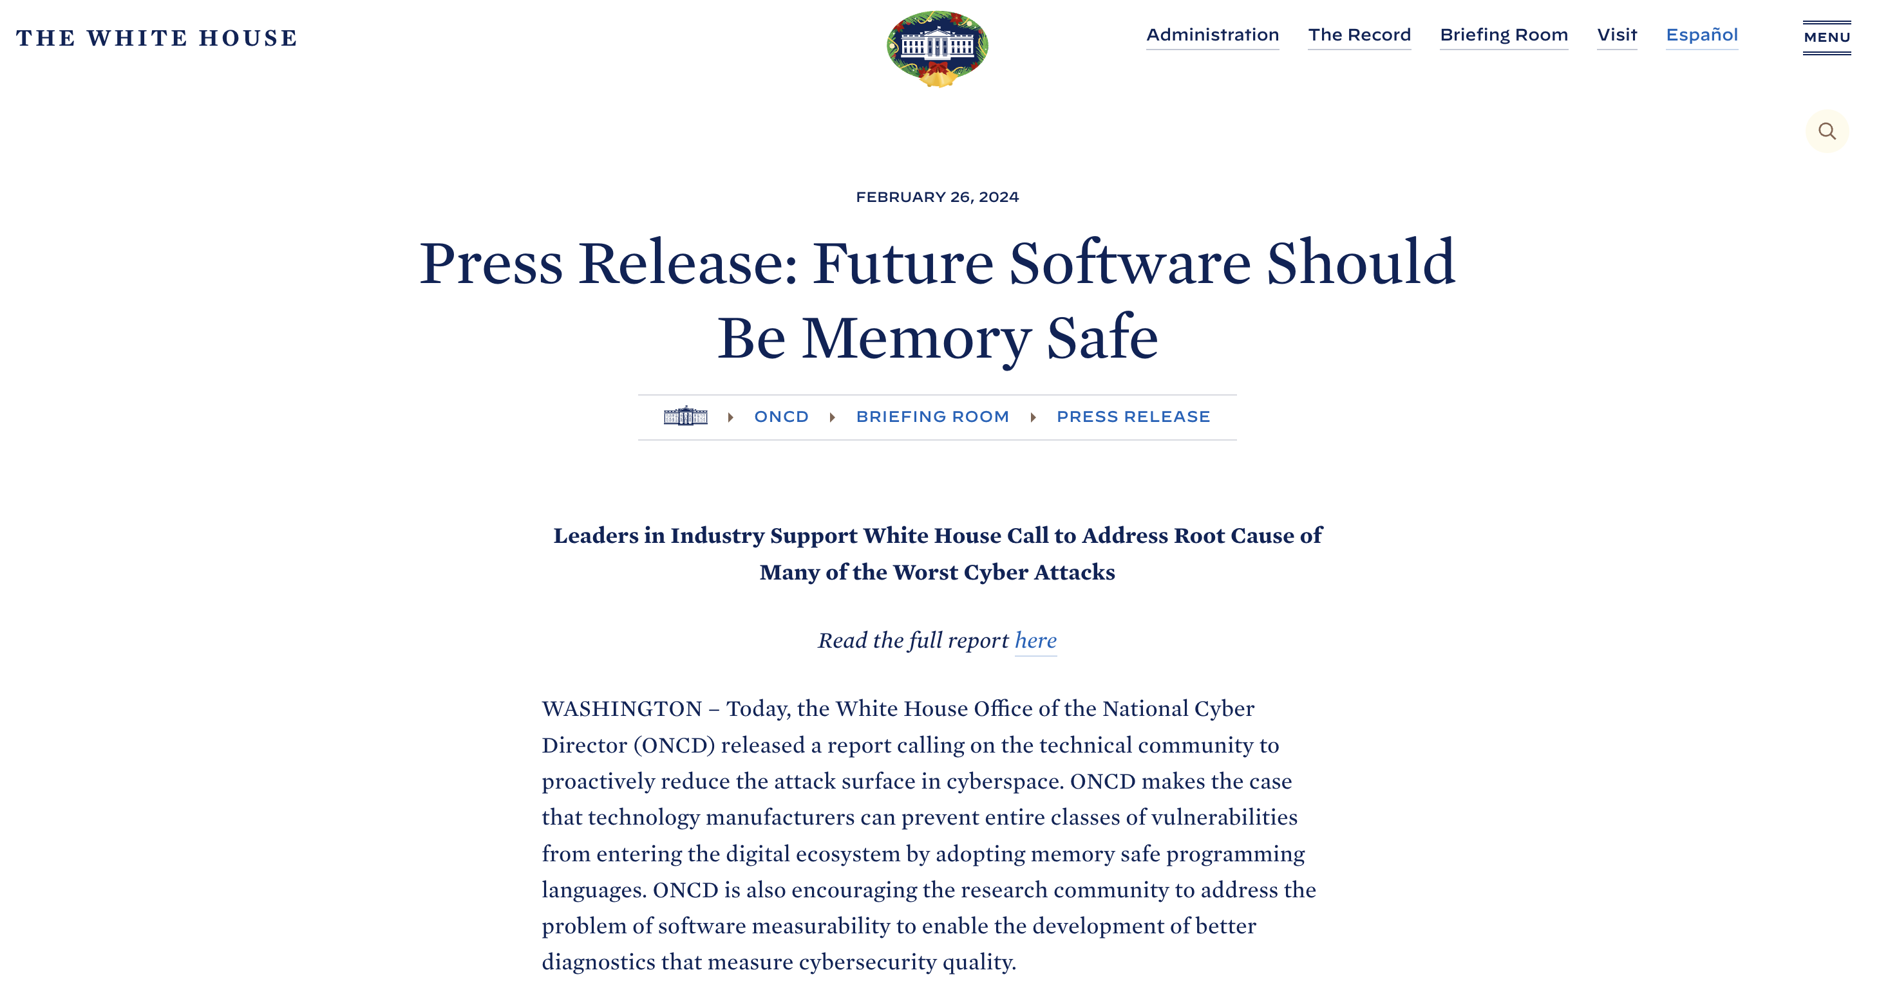
“Some of the most infamous cyber events in history – the Morris worm of 1988, the Slammer worm of 2003, the Heartbleed vulnerability in 2014, the Trident exploit of 2016, the Blastpass exploit of 2023 – were headline-grabbing cyberattacks that caused real-world damage to the systems that society relies on every day. Underlying all of them is a common root cause: memory safety vulnerabilities.”

